Slide 1

RC3 • LIFE IN CHRIST
FOUND
SESSION 1
WHAT DOES IT MEAN
TO BE LOST?
Looking for Belonging Without
Knowing Where Home Is
Fireproof Studies • James J. Burke
Notes:
Welcome students and introduce the series without defining lostness yet. Let the title create the question the lesson will answer.
[Sources]
- /Volumes/T7 Shield/neocities-fireprooofcommentaries/rc3/09_Youth_Resources/Found/Leader_Guides/RC3-Found-Leader-01-WhatDoesItMeanToBeLost.pdf
- /Volumes/T7 Shield/neocities-fireprooofcommentaries/rc3/09_Youth_Resources/Found/Promotion/Source/Found-Facebook-Promo-Background-v1.png

Slide 2
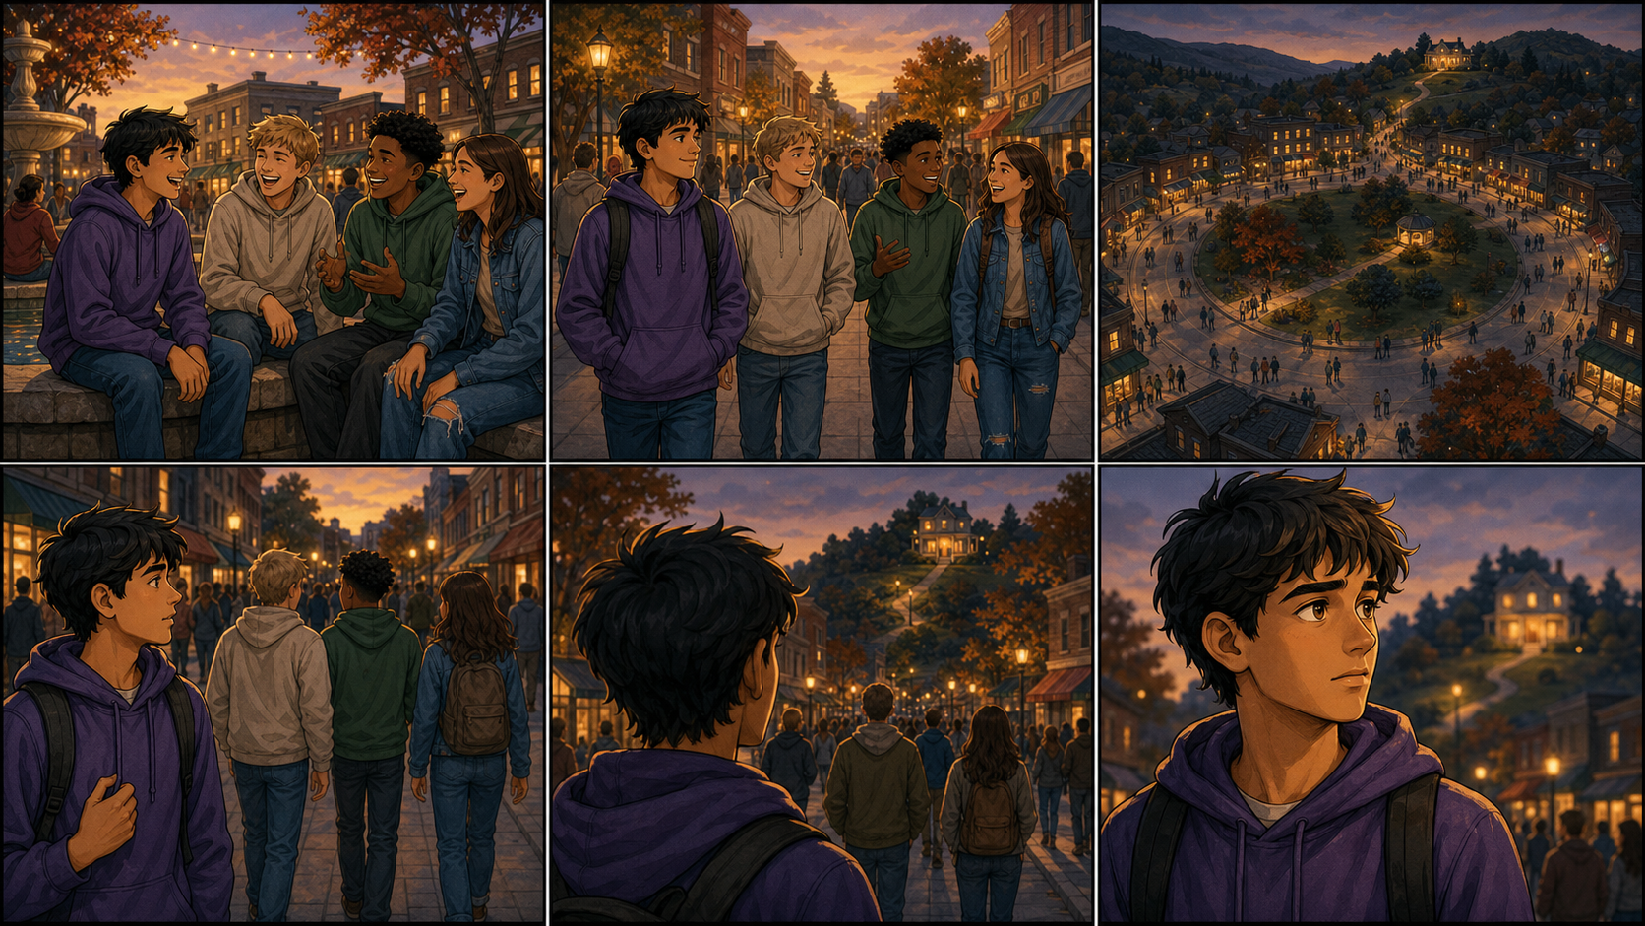
CAN SOMEONE FEEL AT HOME
AND STILL BE LOST?
Don’t answer too quickly.
FOUND • SESSION 1
02
Notes:
Ask the question and allow a few seconds of silence. Invite two or three first reactions. Do not ask students to identify themselves publicly as saved or lost.
[Sources]
- /Volumes/T7 Shield/neocities-fireprooofcommentaries/rc3/09_Youth_Resources/Found/Leader_Guides/RC3-Found-Leader-01-WhatDoesItMeanToBeLost.pdf
- /Volumes/T7 Shield/neocities-fireprooofcommentaries/rc3/09_Youth_Resources/Found/Video_Plans/Session_01_Assets/Found-01-Comfortable-in-the-Wrong-Town-Storyboard-v1.png

Slide 3
OPENING ACTIVITY
Where do I belong?
Name the people, places, groups, and achievements that make someone feel known.
FRIENDS
SCHOOL
FAMILY
TEAMS
WHERE DO
I BELONG?
ONLINE
ACHIEVEMENTS
INTERESTS
CHURCH
These can be real gifts. Can any of them finally tell us who we are and what life is for?
FOUND • SESSION 1
03
Notes:
Build the map with student answers. Honor the real desire beneath each response. Then press gently: good gifts can point beyond themselves, but none can replace the God for whom human life was made.
[Sources]
- /Volumes/T7 Shield/neocities-fireprooofcommentaries/rc3/09_Youth_Resources/Found/Leader_Guides/RC3-Found-Leader-01-WhatDoesItMeanToBeLost.pdf

Slide 4
COMFORTABLE IN THE WRONG TOWN
A whole crowd can feel confident
and still be headed away from home.
Feeling at home is not the same as being home.
FOUND • SESSION 1
04
Notes:
Tell or play the Comfortable in the Wrong Town illustration. Keep the town attractive and the friendships genuine. The point is unrecognized direction, not that ordinary human gifts are sinister.
[Sources]
- /Volumes/T7 Shield/neocities-fireprooofcommentaries/rc3/09_Youth_Resources/Found/Video_Plans/Found-01-Illustrative-Video-Plan.md
- /Volumes/T7 Shield/neocities-fireprooofcommentaries/rc3/09_Youth_Resources/Found/Video_Plans/Session_01_Assets/Found-01-Comfortable-in-the-Wrong-Town-Storyboard-v1.png

Slide 5
BIG IDEA
Lostness is not a label
for unusually bad people.
It describes life apart from the God
for whom human life was made.
A person may look moral, religious, confident, and unaware—and still be far from God.
FOUND • SESSION 1
05
Notes:
State the big idea slowly. Clarify that the Bible's language of lostness describes relationship and direction, not diminished human value.
[Sources]
- /Volumes/T7 Shield/neocities-fireprooofcommentaries/rc3/09_Youth_Resources/Found/Leader_Guides/RC3-Found-Leader-01-WhatDoesItMeanToBeLost.pdf
- /Volumes/T7 Shield/neocities-fireprooofcommentaries/rc3/09_Youth_Resources/Found/Student_Handouts/PNG_Masters/Found-01-Youth-Handout-PNG-Master-v1.png

Slide 6
LUKE 15
Four windows into lostness
Each picture shows something different about what it means to be lost.
1
SHEEP
2
COIN
wandering and helplessness
valuable but out of place
3
YOUNGER SON
4
OLDER SON
chosen estrangement
near the house, far from the father
“...was dead, and is alive again; he was lost, and is found.”
FOUND • SESSION 1
06
Notes:
Read or summarize Luke 15. Ask what each person or object adds. Emphasize: the sheep wanders, the coin retains value, the younger son chooses estrangement, and the older son is near the house without knowing the father.
[Sources]
- /Volumes/T7 Shield/neocities-fireprooofcommentaries/rc3/09_Youth_Resources/Found/Leader_Guides/RC3-Found-Leader-01-WhatDoesItMeanToBeLost.pdf
- /Volumes/T7 Shield/neocities-fireprooofcommentaries/rc3/09_Youth_Resources/Found/Student_Handouts/PNG_Masters/Found-01-Youth-Handout-PNG-Master-v1.png

Slide 7
TRUTH 1
Lostness may
feel normal.
The younger son chose the far country.
The older son stayed nearby—yet neither
understood his father’s heart.
Feeling comfortable does not prove we are where we belong.
FOUND • SESSION 1
07
Notes:
Contrast both sons. A person may be rebellious or respectable, distant or religiously familiar. Present comfort is not the measure of whether someone belongs to God in Christ.
[Sources]
- /Volumes/T7 Shield/neocities-fireprooofcommentaries/rc3/09_Youth_Resources/Found/Leader_Guides/RC3-Found-Leader-01-WhatDoesItMeanToBeLost.pdf
- /Volumes/T7 Shield/neocities-fireprooofcommentaries/rc3/09_Youth_Resources/Found/Video_Plans/Session_01_Assets/Found-01-Comfortable-in-the-Wrong-Town-Storyboard-v1.png

Slide 8
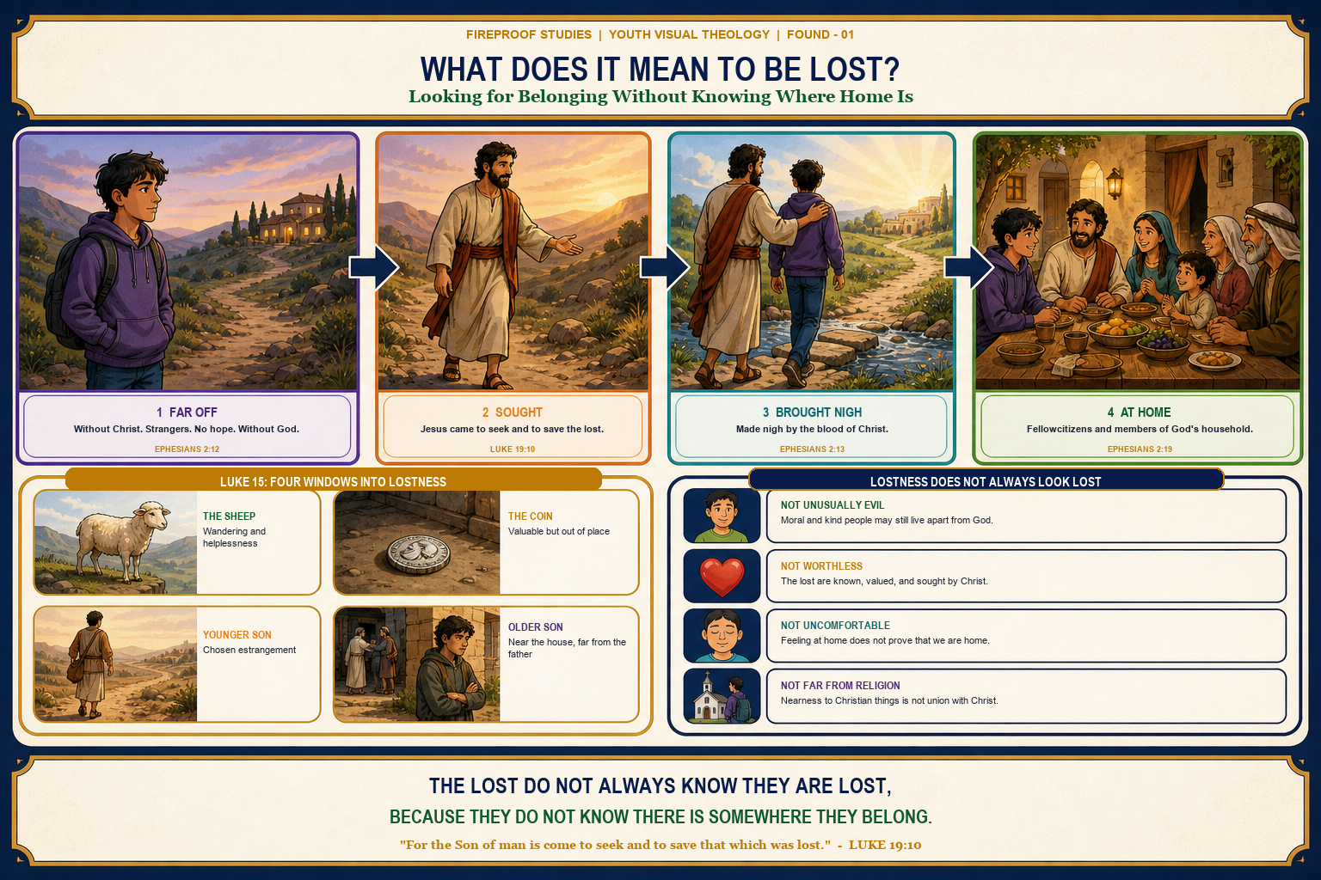
TRUTH 2
Lost does not
mean worthless.
The sheep and coin retain their value while lost. They are known, sought, recovered, and celebrated.
Jesus does not seek the lost because they are worthless.
FOUND • SESSION 1
08
Notes:
Protect human dignity here. Lostness names broken place and relationship; it does not erase worth. The sheep and coin are valuable to the one who searches.
[Sources]
- /Volumes/T7 Shield/neocities-fireprooofcommentaries/rc3/09_Youth_Resources/Found/Leader_Guides/RC3-Found-Leader-01-WhatDoesItMeanToBeLost.pdf
- /Volumes/T7 Shield/neocities-fireprooofcommentaries/rc3/09_Youth_Resources/Found/Visual_Theology/Found-01-Visual-Theology.png

Slide 9
TRUTH 3
Religious nearness
is not union with Christ.
The older son remained near the house, but he did not understand or share the father’s heart.
Being near Christian things is not the same as belonging to Christ.
FOUND • SESSION 1
09
Notes:
Use the older son as a sober warning without assuming which students are saved. Church attendance and Christian familiarity are good gifts, but proximity is not the same as union with Christ.
[Sources]
- /Volumes/T7 Shield/neocities-fireprooofcommentaries/rc3/09_Youth_Resources/Found/Leader_Guides/RC3-Found-Leader-01-WhatDoesItMeanToBeLost.pdf
- /Volumes/T7 Shield/neocities-fireprooofcommentaries/rc3/09_Youth_Resources/Found/Visual_Theology/Found-01-Visual-Theology.png

Slide 10
THE GOSPEL MOVEMENT
Jesus came to bring the lost home
1
2
3
4
FAR OFF
SOUGHT
BROUGHT NEAR
AT HOME
without Christ
Jesus seeks and saves
by the blood of Christ
God’s household
Christ does more than improve life in the far country. He seeks, saves, brings near, and makes strangers members of God’s household.
EPHESIANS 2:12–13, 19 • LUKE 19:10
FOUND • SESSION 1
10
Notes:
Trace the movement in Ephesians 2. Keep Christ as the acting center: He seeks and saves the lost; His blood brings the far-off near; in Him strangers become members of God's household.
[Sources]
- /Volumes/T7 Shield/neocities-fireprooofcommentaries/rc3/09_Youth_Resources/Found/Leader_Guides/RC3-Found-Leader-01-WhatDoesItMeanToBeLost.pdf
- /Volumes/T7 Shield/neocities-fireprooofcommentaries/rc3/09_Youth_Resources/Found/Student_Handouts/PNG_Masters/Found-01-Youth-Handout-PNG-Master-v1.png

Slide 11
DISCUSSION
Let’s think it through
1
Where do teenagers most often look for belonging?
2
Why might a lost person not feel lost?
3
How can someone stay near Christian things without knowing God?
4
What does Jesus do that the lost cannot do for themselves?
Listen honestly. Answer from Scripture. Leave room for questions.
FOUND • SESSION 1
11
Notes:
Choose questions according to time. Helpful follow-ups: Which kinds of belonging can be good without being enough? What can make life away from God feel normal? Trace seek, save, bring near, and make family.
[Sources]
- /Volumes/T7 Shield/neocities-fireprooofcommentaries/rc3/09_Youth_Resources/Found/Leader_Guides/RC3-Found-Leader-01-WhatDoesItMeanToBeLost.pdf

Slide 12
MEMORY VERSE • LUKE 19:10
“For the Son of man is come
to seek and to save that which was lost.”
Jesus came to seek the lost and bring them home to God.
THIS WEEK
YOU MAY TALK WITH US
Notice where you seek the answer to:
“Where do I belong?”
Bring one honest observation next week.
If you wonder whether you belong to Christ, you do not have to answer publicly or pretend certainty. A leader will listen and open the Bible with you privately.
FOUND • SESSION 1
12
Notes:
Read the memory verse together. Explain the seven-day belonging audit. Close in prayer. Offer a private conversation without pressure, public identification, or automatic reassurance.
[Sources]
- /Volumes/T7 Shield/neocities-fireprooofcommentaries/rc3/09_Youth_Resources/Found/Leader_Guides/RC3-Found-Leader-01-WhatDoesItMeanToBeLost.pdf
- /Volumes/T7 Shield/neocities-fireprooofcommentaries/rc3/09_Youth_Resources/Found/Student_Handouts/PNG_Masters/Found-01-Youth-Handout-PNG-Master-v1.png
- /Volumes/T7 Shield/neocities-fireprooofcommentaries/rc3/09_Youth_Resources/Found/Promotion/Source/Found-Facebook-Promo-Background-v1.png

